Slide 1


A Comparative Study of Neural Network Optimizers
by Hiba Khurshid

Slide 2
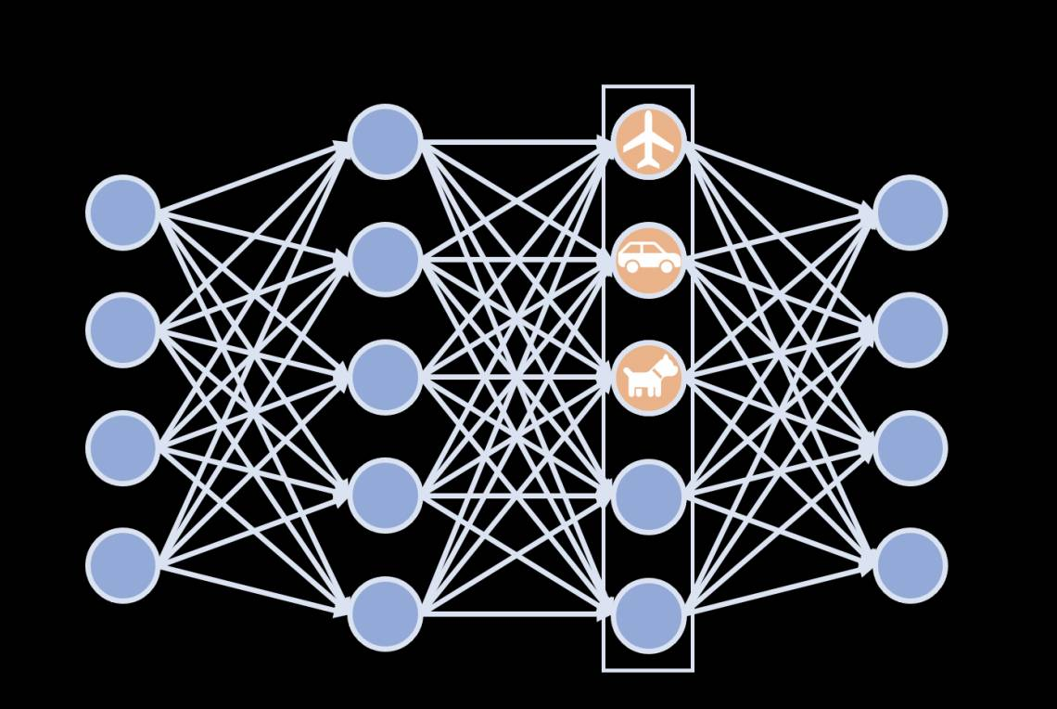
Neural Networks and Optimization
Neural networks mimic the human brain, consisting of layers of interconnected neurons.
Each connection has a weight, adjusted during training to minimize errors.
Optimization is the backbone of neural network training, finding the best weights for accurate predictions.
Gradient Descent and its variants are key techniques for optimization.
Goal: Achieve faster convergence, higher accuracy, and computational efficiency.
Notes:
"Neural networks are inspired by the human brain, consisting of layers of neurons that work together to process information. These neurons are connected by weighted links, and during training, the network learns by adjusting these weights to minimize errors in predictions.
Optimization plays a crucial role in this training process, acting as the guide that helps the network find the most effective weight configuration. One of the most widely used techniques for optimization is Gradient Descent, along with its advanced variants like Adam, RMSprop, and others.
In this presentation, we'll explore how different optimization techniques work and compare their performance on a practical deep learning task. Our focus will be on their convergence speed, accuracy, and computational efficiency."

Slide 3


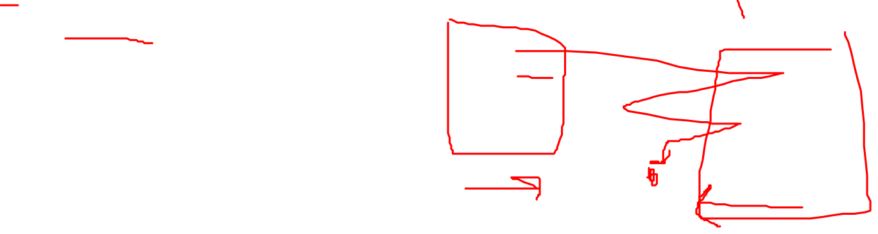
Gradient Descent Optimization
An iterative optimization algorithm used to minimize a function by adjusting parameters in the direction of the negative gradient
Mathematical Formula
$$wt=w_{t−1}−\text{η}\text{.}\frac{dL}{dw}$$
Algorithm
Initialize weights randomly.
Compute the gradient of the loss function.
Update weights using the formula above.
Repeat until convergence or predefined epochs.
Notes:
"Gradient Descent is one of the most fundamental optimization techniques used in machine learning. It works by iteratively updating the weights of a model to minimize the loss function, which measures how far the model's predictions are from the actual values.
The weight update formula, shown here, adjusts the weights by moving them in the direction opposite to the gradient of the loss function. The learning rate, η\etaη, controls the size of these steps. A small learning rate ensures stable but slow progress, while a large one may lead to overshooting the minimum.
The algorithm begins by initializing weights, calculating the gradient of the loss function with respect to these weights, and then updating them. This process repeats for each epoch until the model converges or the set number of epochs is reached. This systematic adjustment allows Gradient Descent to gradually approach the minimum of the loss function, enabling the model to improve its performance."

Slide 4


Mini-Batch Gradient Descent
A variant of Gradient Descent that updates weights using small, random subsets (mini-batches) of the dataset.
Mathematical Formula
$wt=w_{t−1}−\text{η}\text{.}\frac{dL}{dw}$ (mini-batch)
Algorithm
Divide the dataset into mini-batches.
For each mini-batch:
Compute gradients of the loss function.
Update weights using the formula above.
Repeat for all mini-batches and epochs

Slide 5
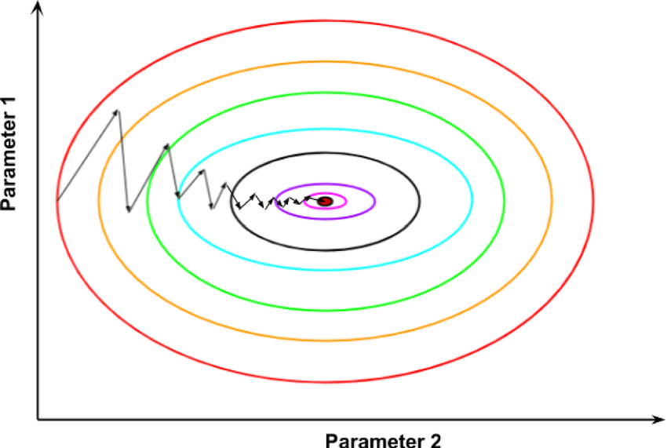
Mini-Batch Gradient Descent
Advantages:
Reduces memory requirements by working with mini-batches.
Faster convergence compared to Batch Gradient Descent.
Introduces stochasticity, which helps in avoiding local minima.
Parallelizable, improving computational efficiency on GPUs.
Best Use Cases:
Ideal for large datasets where full-batch updates are computationally expensive.
Works well for training deep learning models like CNNs and RNNs.
Suitable for scenarios requiring a balance between speed and stability.

Slide 6
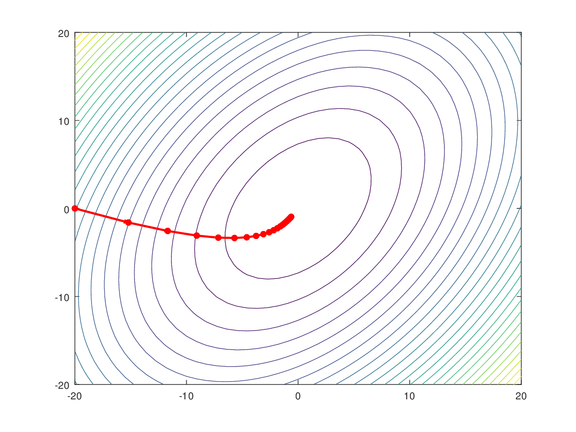
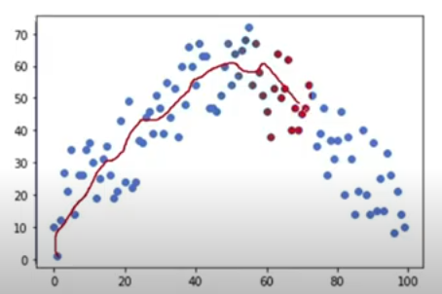

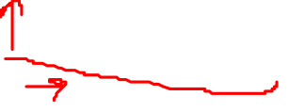
Momentum Optimizer
Mathematical Formula
$$w=w−α ∗V_{dw}$$
$V_{dwt}$ = ${β∗V}_{dwt−1}+\left(1−β\right)dW$
Exponentially Weighted
moving average

Slide 7



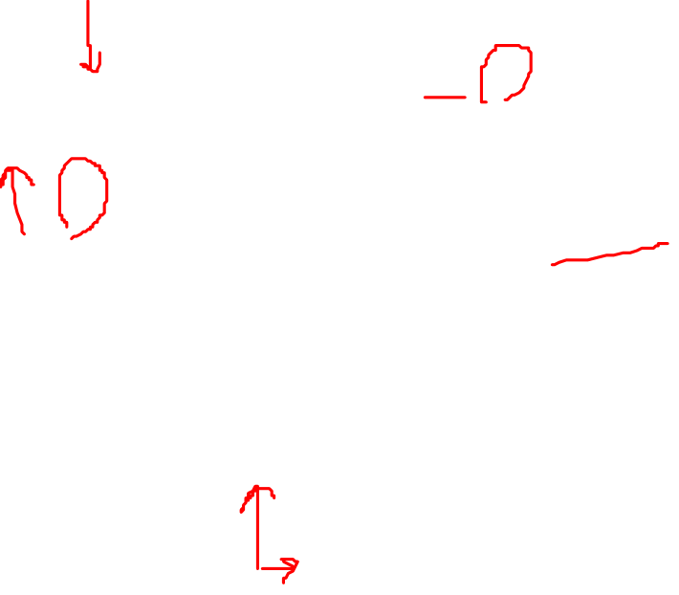
RMSprop Optimizer:
RMSprop (Root Mean Square Propagation) is an optimization algorithm designed to adapt the learning rate for each parameter based on the moving average of squared gradients.
Mathematical Formula
$$wt=w_{t−1}−\frac{\text{η}}{\sqrt{v_{t}+∈}}\text{.}\frac{dL}{dw}$$
$$v_{t}=β∗v_{t−1}+(1−β){(\frac{dL}{dw})}^{2}$$

Slide 8
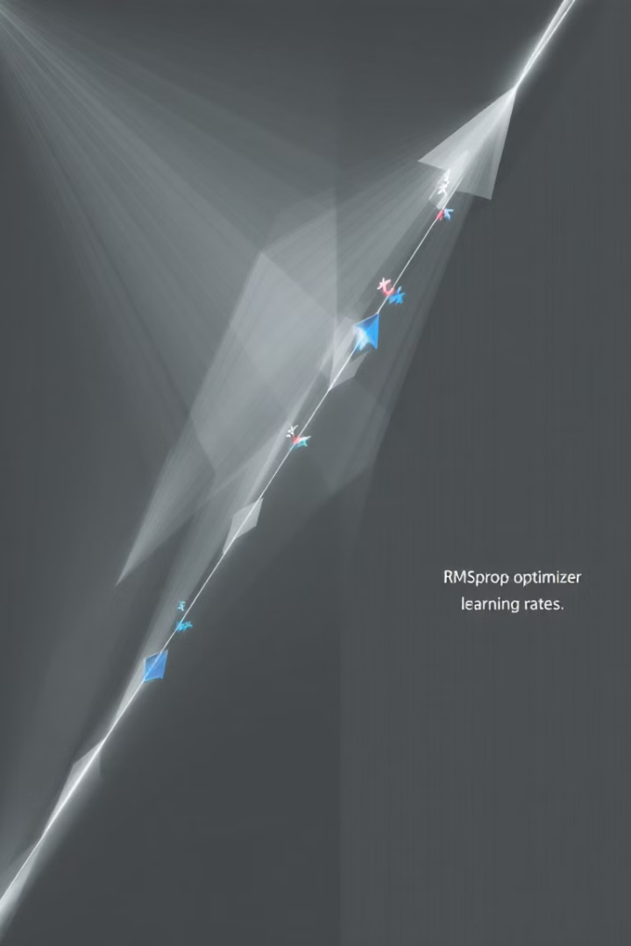
How it works
Maintains a moving average of squared gradients.
Divides the learning rate by the root mean square of these averages to normalize updates.
Helps handle non-stationary objectives and smooth convergence
Advantages
Adapts learning rate for each parameter dynamically.
Effective for non-stationary objectives and noisy gradients.
Prevents oscillations in the optimization process.
Requires minimal tuning of hyperparameters.
Notes:
"RMSprop comes with several advantages that make it a popular choice for many deep learning applications. Its ability to adaptively adjust the learning rate for each parameter helps ensure stability and efficient convergence. This is especially important for problems with non-stationary objectives, such as those encountered in time-series data or reinforcement learning.
A key advantage of RMSprop is its ability to reduce oscillations during optimization, which is a common problem in gradient descent. It achieves this by normalizing parameter updates using the square root of the moving average of squared gradients. This feature also makes it robust to noisy gradients, which often occur in deep networks.
RMSprop is particularly suited for tasks like training RNNs or handling sparse gradients. For example, when dealing with long sequences in natural language processing or time-series prediction, RMSprop shines because of its stability and efficiency. These traits make it a reliable choice for large-scale and complex neural network training."

Slide 9


Adam Optimizer
Adam (Adaptive Moment Estimation) combines the strengths of Momentum and RMSprop to achieve adaptive learning rates for each parameter
Mathematical Formula
$$wt=w_{t−1}−\text{η}\frac{V_{dw}}{\sqrt{v_{t}+∈1}}\text{.}\frac{dL}{dw}$$
Advantages
Combines the strengths of Momentum and RMSprop.
Adapts learning rates for each parameter dynamically.
Robust to sparse gradients and noisy data.
Bias correction improves early-stage optimization.
Works well with large datasets and complex architectures.
Notes:
The Adam optimizer, short for Adaptive Moment Estimation, is one of the most widely used optimization algorithms in deep learning. It is designed to combine the benefits of both Momentum and RMSprop optimizers. Specifically, Adam tracks the first moment, which represents the mean of the gradients, and the second moment, which corresponds to the uncentered variance of the gradients.
This dual approach allows Adam to adjust the learning rate dynamically for each parameter, ensuring that updates are both directionally accurate and appropriately scaled. Bias correction is applied to counteract initialization effects, leading to more reliable estimates of the first and second moments during the early stages of training.
The result is an optimizer that is efficient, versatile, and robust. It performs well across a wide range of tasks, making it a default choice for many practitioners in deep learning. The equations summarize its working, showing how Adam computes parameter updates based on the bias-corrected estimates of moments and a normalized learning rate.

Slide 10


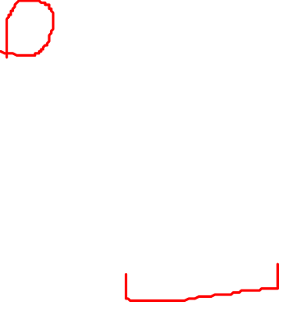
AdaGrad Optimization
Adapts the learning rate for each parameter based on the history of gradients
Mathematical Formula
$$wt=w_{t−1}−\frac{\text{η}}{\sqrt{S_{dw}+ε}}\text{.}\frac{dL}{dw}$$
$$wS_{dwt}=S_{dwt−1}+({\frac{dL}{dw}}^{2})$$
Advantages
Automatically adapts learning rates for each parameter.
Effective in handling sparse gradients.
Focuses on rarely updated features, ensuring better optimization for such parameters.
Simple implementation and computationally efficient.
Notes:
"AdaGrad, or Adaptive Gradient Algorithm, is an optimization technique that adapts the learning rate for each parameter based on its historical gradients. This unique approach ensures that parameters with frequent updates in earlier iterations receive smaller updates in later stages, leading to more stable convergence.
The core mechanism involves accumulating the squared gradients for each parameter. This accumulation is then used to normalize the gradients, effectively scaling the learning rate inversely with the magnitude of past gradients. This allows AdaGrad to focus on infrequently updated parameters, making it particularly useful for sparse gradient problems.
However, a notable characteristic of AdaGrad is that the learning rate tends to decrease over time as the accumulation grows, which can slow down training or lead to stagnation in long-term optimization."

Slide 11

Comparison of Optimizers on CIFAR-10 Dataset
Dataset
Composed of 60,000 images categorized into 10 classes (e.g., airplanes, dogs, cars).
Each image is 32x32 pixels, RGB color.
Training Set: 50,000 images and testing Set: 10,000 images.
Widely used for benchmarking image classification models
Comparison Metrics
Accuracy on test data.
Training time.
RAM occupancy (peak memory usage in MB).
Convergence behavior (loss and accuracy trends).
Code: https://github.com/hibakhurshid96/Neural-Network-Optimizer-

Slide 12
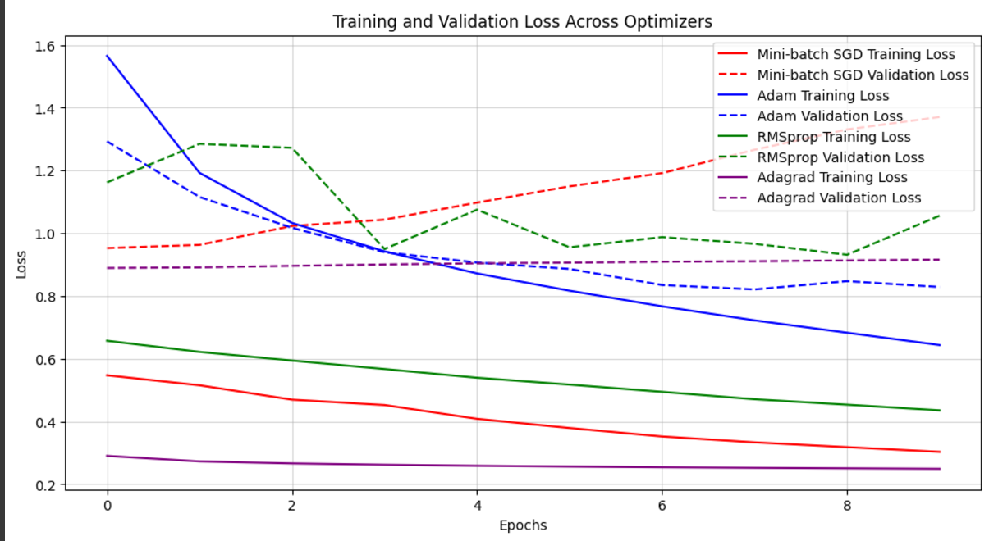
Convergence behavior

Slide 13
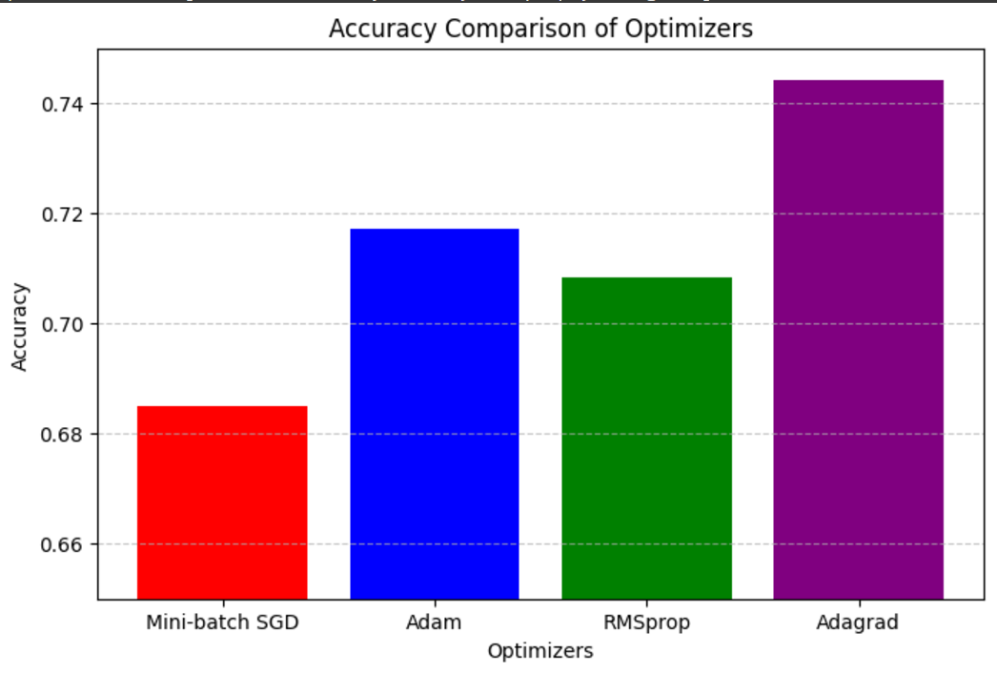
Accuracy Result
Optimizers | Accuracy
Mini- Batch SGD | 0.68
RMSProp | 0.70
Adam | 0.71
AdaGrad | 0.74

Slide 14
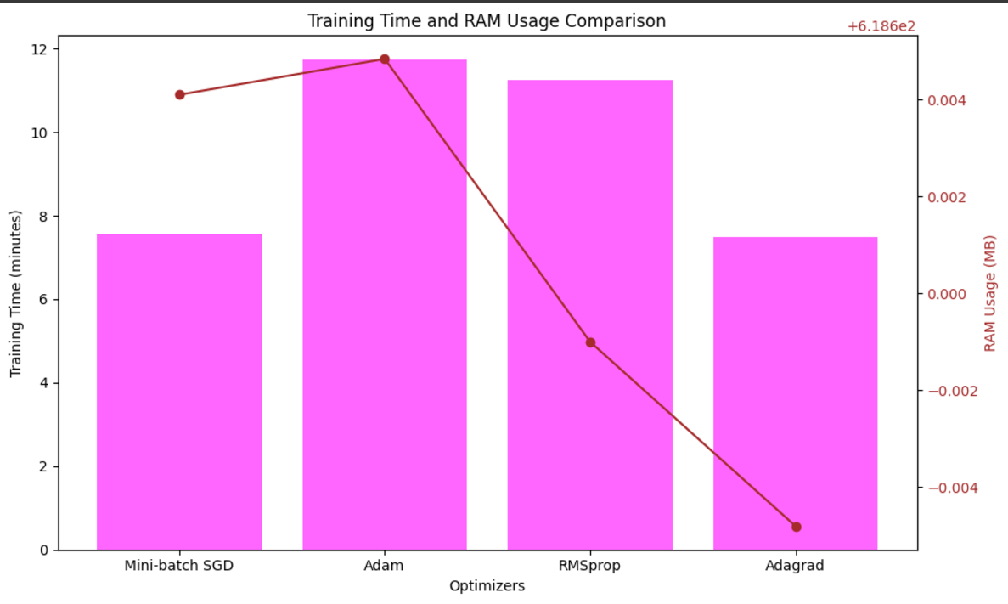
Time and Memory Performance

Slide 15
References:
Abdolrasol, M. G. M., Hussain, S. M. S., Ustun, T. S., Sarker, M. R., Hannan, M. A., Mohamed, R., Ali, J. A., Mekhilef, S., & Milad, A. (2021). Artificial Neural Networks Based Optimization Techniques: A Review. Electronics, 10(21), 2689. https://doi.org/10.3390/electronics10212689
Zhang, Z. (2018). Improved Adam Optimizer for Deep Neural Networks. Proceedings of the 2018 IEEE/ACM 26th International Symposium on Quality of Service (IWQoS), Calgary, Canada.
Desai, C. (2020). Comparative Analysis of Optimizers in Deep Neural Networks. International Journal of Innovative Science and Research Technology, 5(10), 959–963. https://www.ijisrt.com

